Slide 1
Defect Predictor
Progress Demo – 22 Oct 2021

Slide 2
Problem Statement and Planning
Defect prediction which can differentiate between two levels of defects with an accuracy indicator.
This can be further broken down to:
Find a suitable dataset.
Groom the dataset.
Suitable algorithm for regression.
Train, Test, Validate.
Final working prototype in python
Notes:
Find a suitable dataset.
Has enough datapoints
Has defects which can be classified
Groom the dataset
Remove Null values
Check formatting and repeated instances.
Organising in a usable way
Normalize data ?
Look into suitable algorightms to perform prediction.

Slide 3
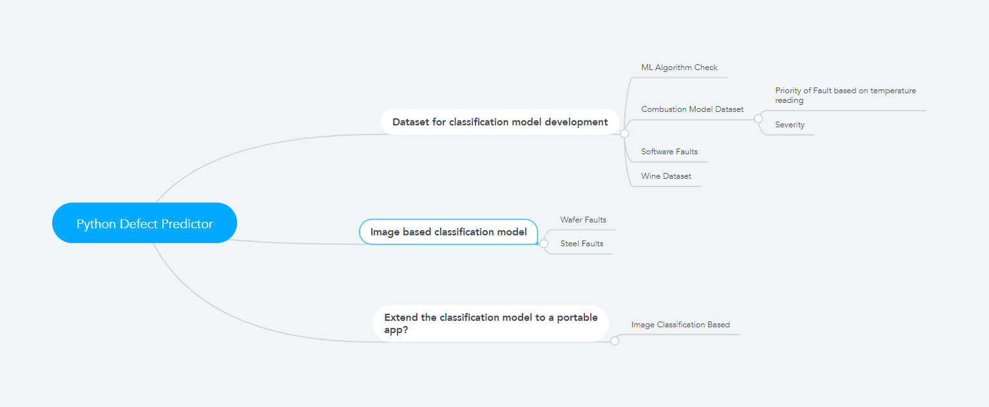
Ideas

Slide 4
Dataset Selection
Features
Fixed Acidity
Volatile Acidity
Citric Acid
Residual Sugar
Chlorides
Free Sulfur Dioxide
Total Sulfur Dioxide
Density
pH
Sulphates
Alcohol
Wine Quality Dataset
Has 11 unique features
Approx. 5000 samples
Final outcome – Quality (1-10)
https://www.kaggle.com/uciml/red-wine-quality-cortez-et-al-2009

Slide 5
Data Grooming
Converted Quality to a binary feature
0-5 -> 0 (Bad)
6-10 -> 1 (Good)
Removed incomplete samples
Final dataset, approx. 1600 samples.
Data Split
Train/Test – 70/30
Notes:
Converted Quality to a binary feature
0-5 -> 0 (Bad)
6-10 -> 1 (Good)
In order to classify them into two categories.
Can this be extended into 3 categories ?? ( Worse (1-3), bad (4-7), Good(8-10) ) ??
Removed incomplete samples
Final dataset, approx. 1600 samples.
Removed NaN values
Data Split
Train/Test – 85/15 ??
Test with varying splits ?

Slide 6
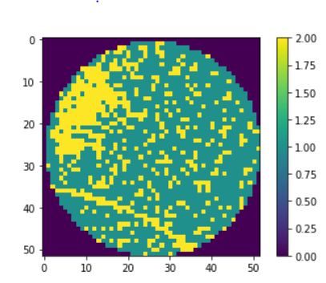
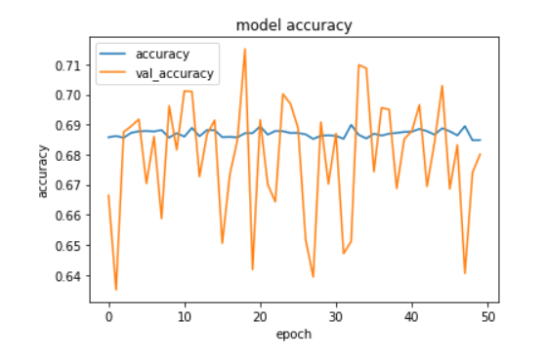


Further Work
Image classifier
Wafer Defect Detector
Current status
68%-70% prediction accuracy
Software Defect Dataset
Extend Logistic Regression model
Current status
Neural Network Architecture Preperation
Classifier on Mobile App
User takes picture, defect detecte
Current status
TBD
https://www.tensorflow.org/lite/examples/image_classification/overview

